Slide 1
Looking for a place to live?
A tool to help you consider all popular venues
in your future living!

Slide 2
What to think of when you move places?
Important considerations:
Costs of the living
Proximity to your job
Mobility
And….
Venues
Such as : grocery stores, book stores, cinema’s, schools, coffee shops, offices, and many many more.

Slide 3
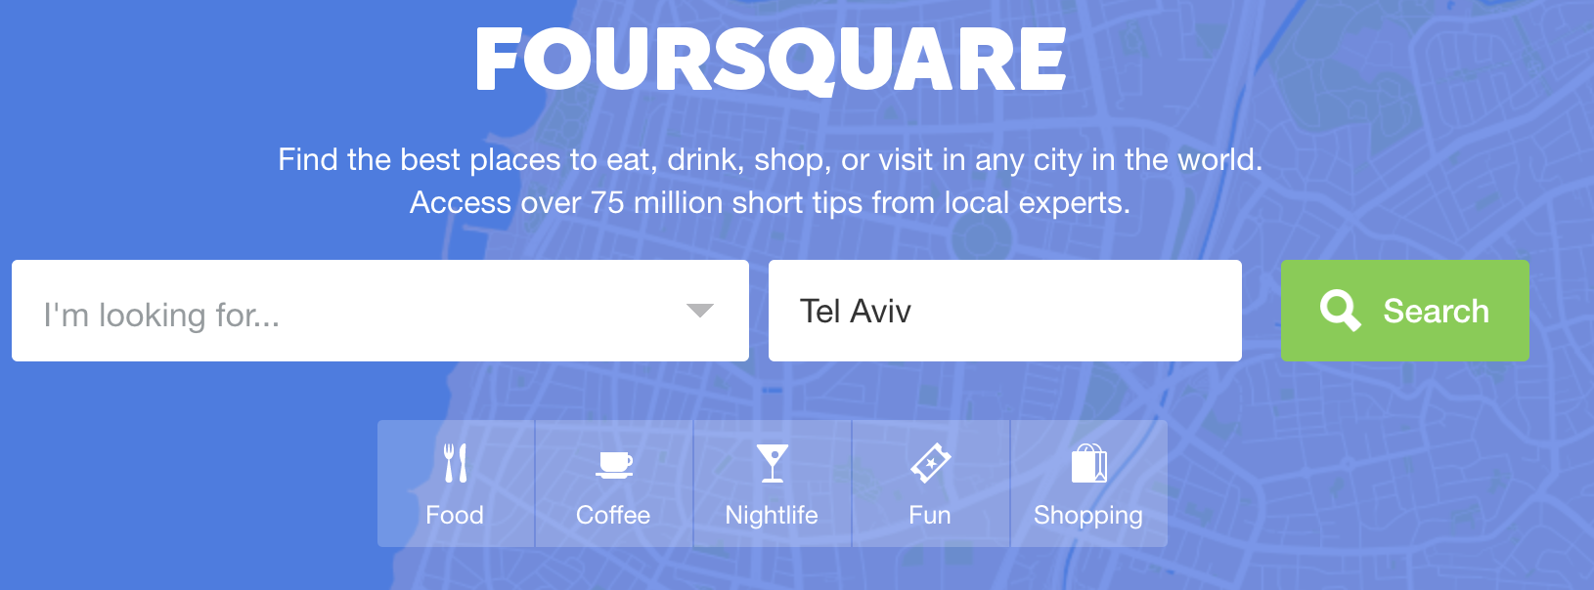
Foursquare

Slide 4
Foursquare data available for developers
Make calls to the Foursquare database to get:
Recommendation feedback from users
personal data of users
Top venues in the vicinity of any location of your choice.

Slide 5

A tool to help you find a neighborhood that fits –You--
Foursquare data describing top venues in neighborhoods of the users choice
+
User input defining the importance for each specific venue in these neighborhoods
Neighborhood fitting your preferences!

Slide 6
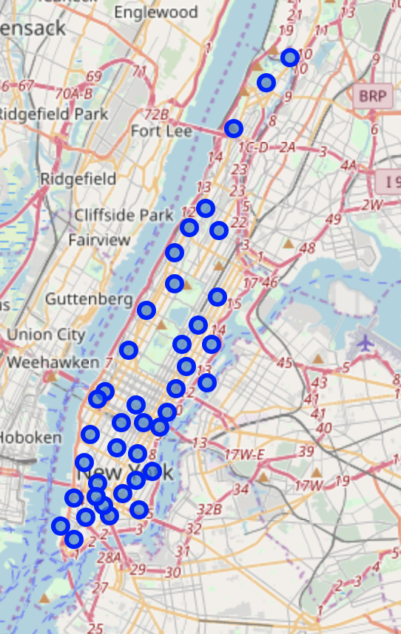
Bobby looks for a neighborhood in Manhattan
Manhattan contains 39 neighborhoods,
all having different venues…

Slide 7
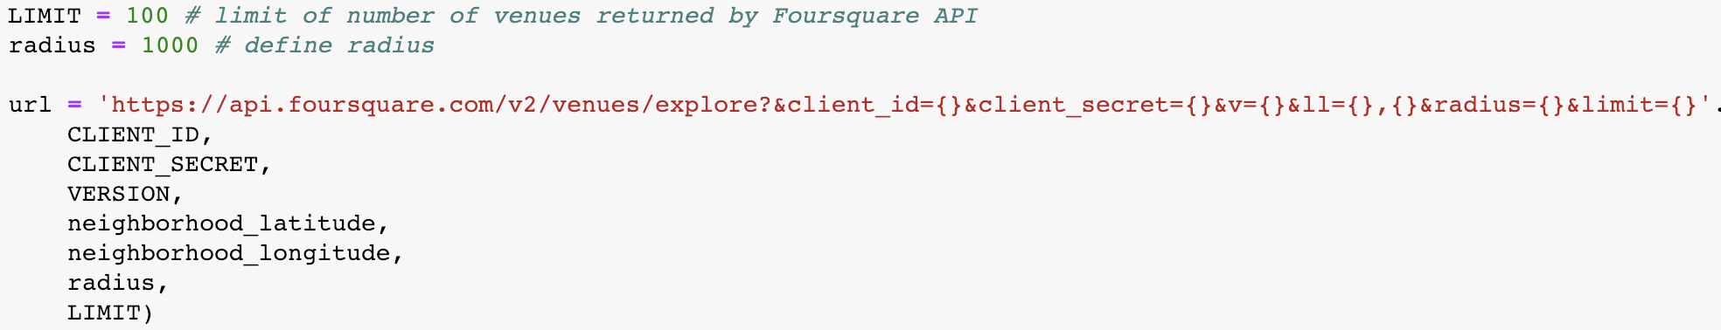
Making the call to the foursquare database
This call gets the top 100 venues in a 1km radius around the coordinates of all the 39 neighborhoods.

Slide 8
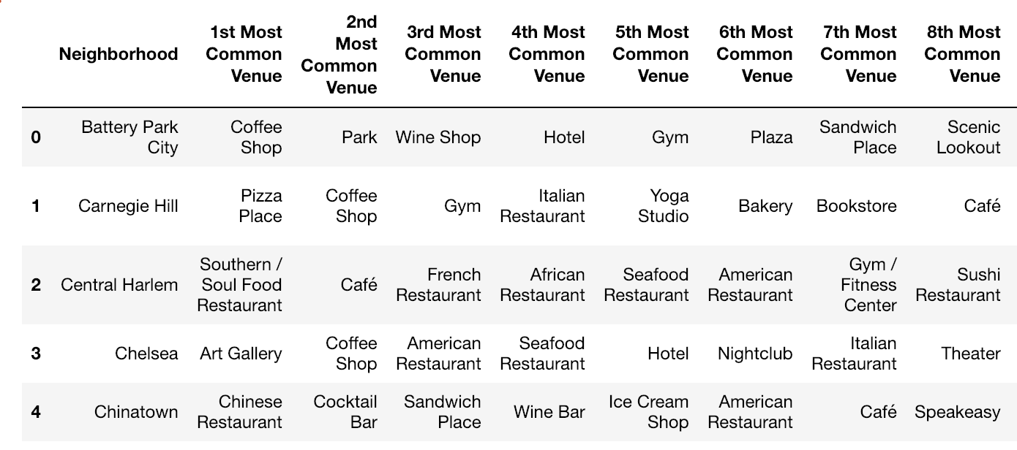
Organizing the top 20 venues for each neighborhood

Slide 9
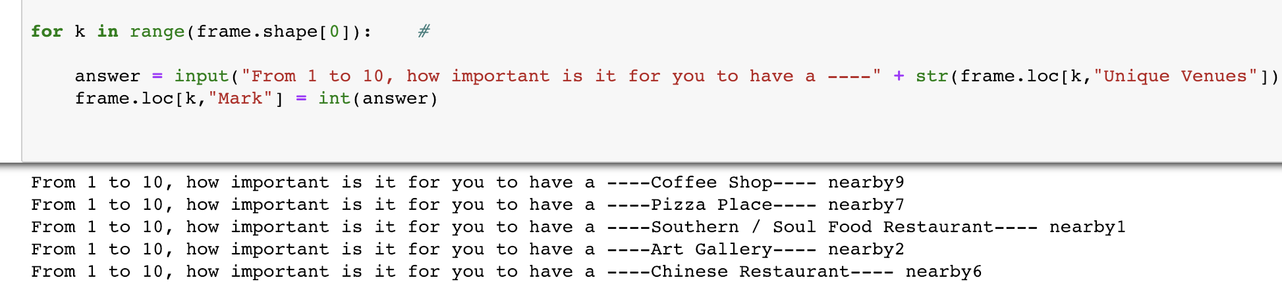
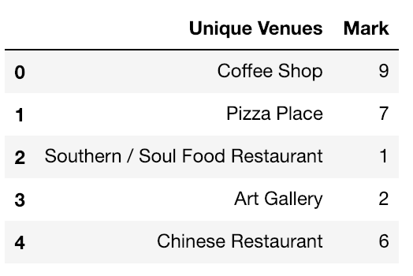
Requesting input for all specific venues in these neighborhoods

Slide 10
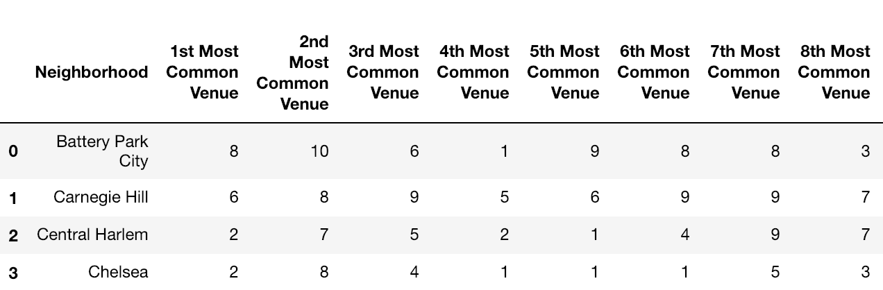
Replacing the venues names with their user-based rating

Slide 11
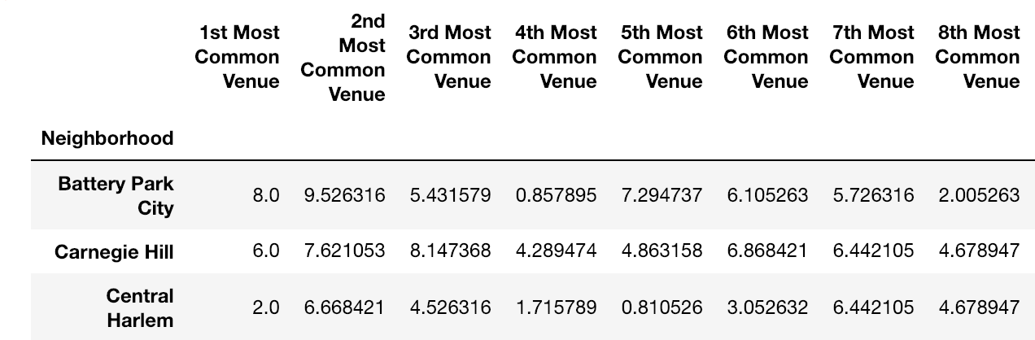
Calculating the weighed importance
As the 1st most common venue is more typical of that neighborhood, it’s weight is calculated to be more.

Slide 12
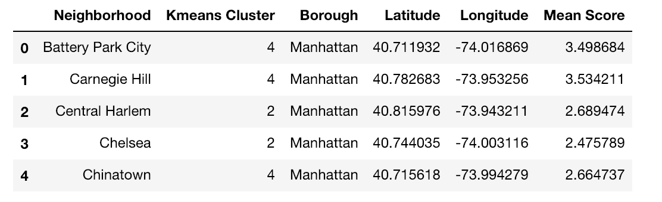
Clustering the dataset using Kmeans clustering

Slide 13
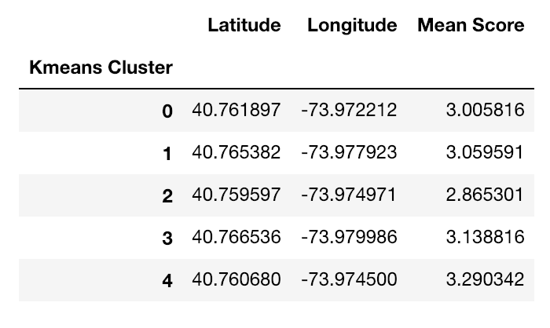
Calculating the average score for each cluster

Slide 14
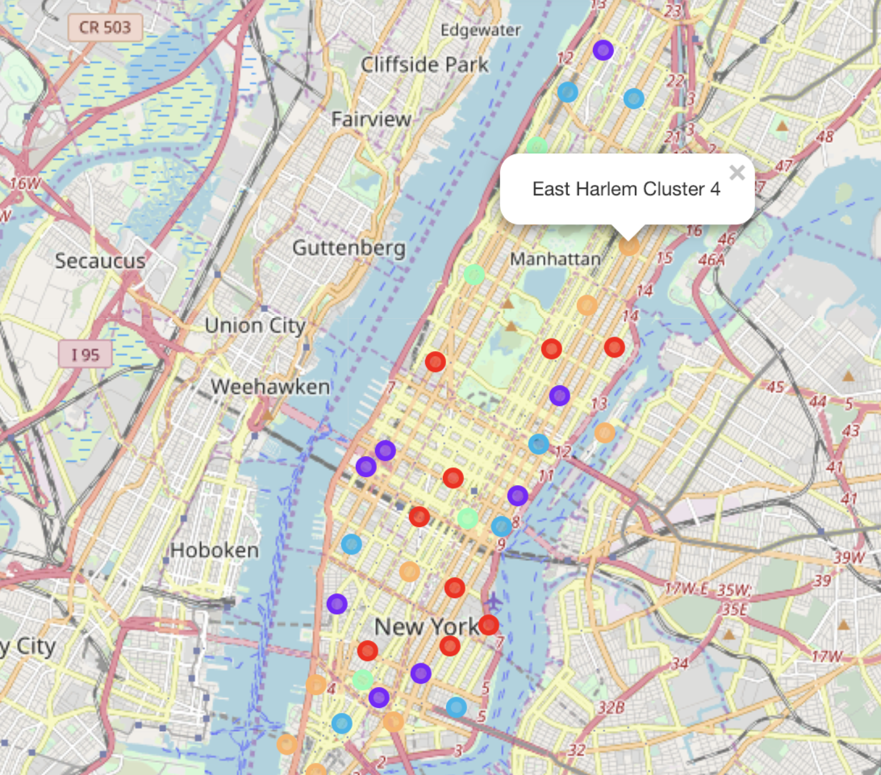
Visualizing these clusters
The user can find clusters that his/her preferences better, therefore adding another consideration when looking for a new living.

Slide 15

Thank you =)

